Slide 1
Data Stories
Using operational data to highlight the impact of cores

Slide 2
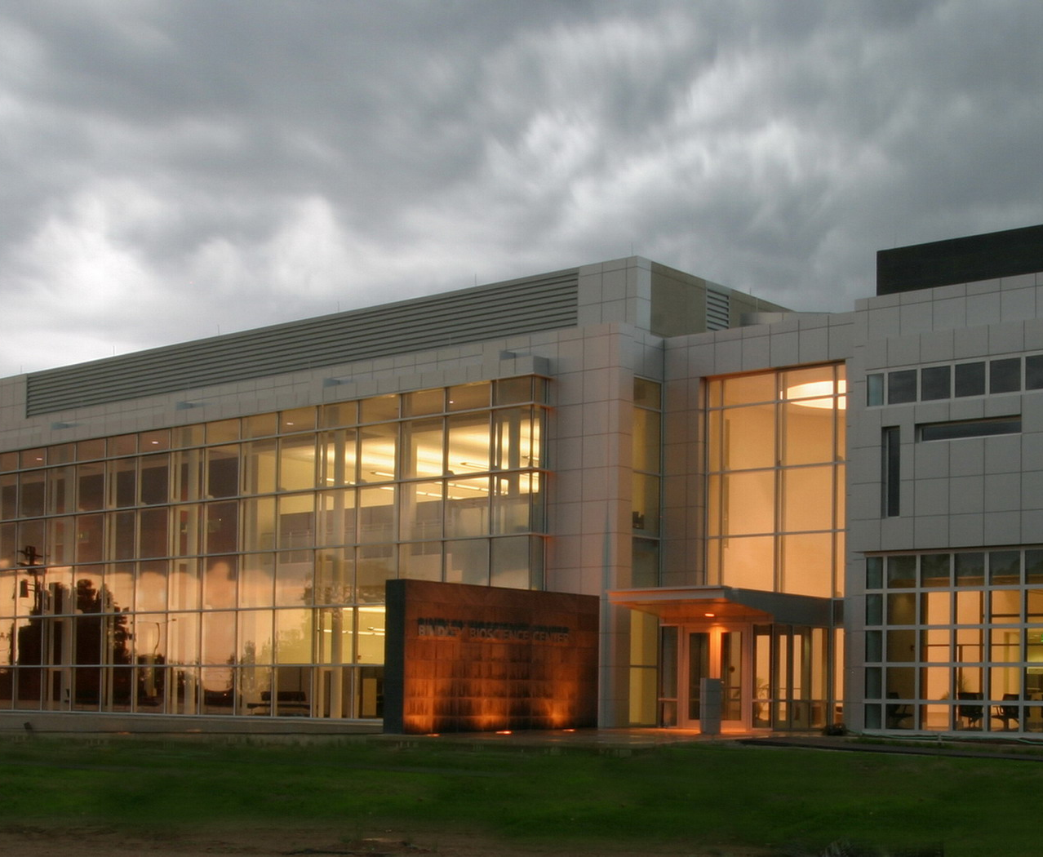
Bindley Bioscience Center
Hub for Purdue’s centrally managed life science core facilities
Ten core facilities across five broad domains
Chemistry and Biochemistry
Imaging Across Scales
Animal Models
Cellular Biology and Single-cell Analysis
Computational Biology
Our team
20 research staff
2 research faculty
3 postdocs/grad students

Slide 3
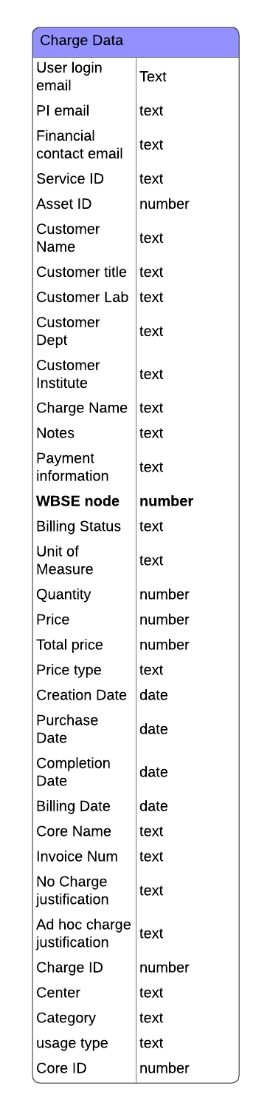
Where we get data
2017 – iLab arrives
Operational Metrics
Instrument time used (efficiency)
User base – users/faculty labs
Research/Science Metrics
Grants actively supported by the cores
Publications acknowledging the cores
Education Metrics
Number of trained users who can independently use the core
Workshops, guest lectures, etc

Slide 4
Where we get data
2018 – master data business process and account update
F.XXXXXXXX.XX.XXX
Ability to easily track funding source – external sponsored funding, startup, restricted, discretionary
Sponsored program office adds more granular detail to data – specific federal agencies, industrial sponsors, foundations, state sponsors, etc.
PI Identifier
WBSE node
Project code

Slide 5
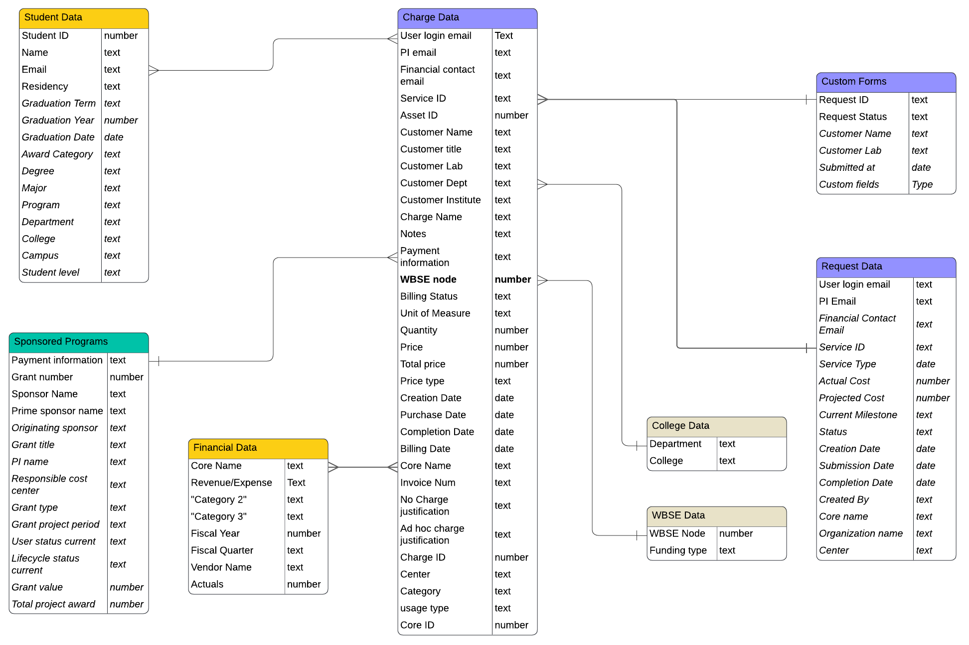
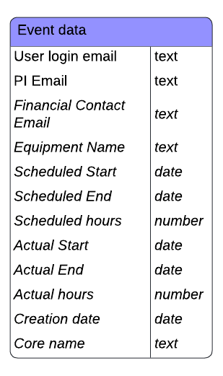
The Data Model

Slide 6
What do we do with all this data?
Part 1 - Operations
How are users interacting with the core?
  How are we attracting and retaining users?
What are the workflows in the core?
  What are the critical data to look at?
  Where do staff spend their time?
  What can that tell us about resource needs, before it becomes an emergency?

Slide 7
Attracting New Users
New users and new faculty in the Metabolomics Core

Slide 8
User Retention
How many users come back to the Metabolomics Core?
29% of faculty
21% of faculty
70% of faculty return within 1 year
74% return within 3 years
70% of users return within 1 year
73% return within three years

Slide 9
Metabolomics Projects
FY26
58%
FY19

Slide 10
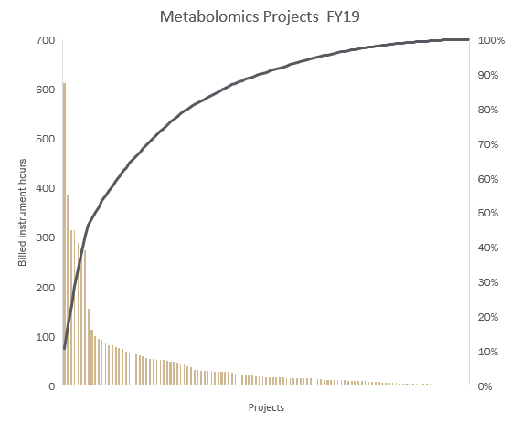
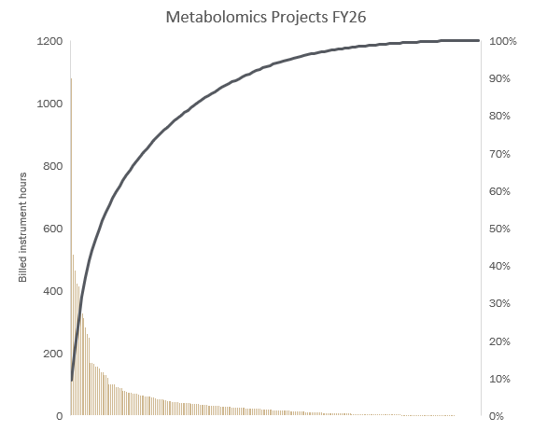
How do the projects break down?
37 projects used 80% of the instrument time
10 projects over 100 hours
63 projects under 20 hours
65 projects used 80% of the instrument time
26 projects over 100 hours
126 projects under 20 hours

Slide 11
What’s the workflow?
Time dependent on number of samples
Sample prep
Run samples
Data processing
Project intake
Method Development
Data analysis and reporting
User Training
Staff time required
Independent of project size
Small projects disproportionately impact staff time
Staff or Data Analysis Core
Sample prep
Run samples
Data Processing
Trained user time

Slide 12
More projects, less FTE
Workflow | Δ Projects | Δ FTE
Targeted | 65% | 0
Untargeted | 23% | 0.5
Lipidomics | 50% | 0.5
Imaging MS | 200%

Slide 13
Modeling staff time for the untargeted workflow
Without a data analyst
The core director spends over half his time on data analysis and reporting
Technical staff spend time on data processing and basic analysis
With a data analyst
Wet lab staff are free to focus on bringing projects into the core and running instruments
Analyst Scientist Director
Analyst Scientist Director
Analyst Scientist Director

Slide 14
What do we do with all this data?
Part 2 - Research
Show the impact of core facilities on research
University research initiatives
Grant expenditures
Cores as research enablers

Slide 15
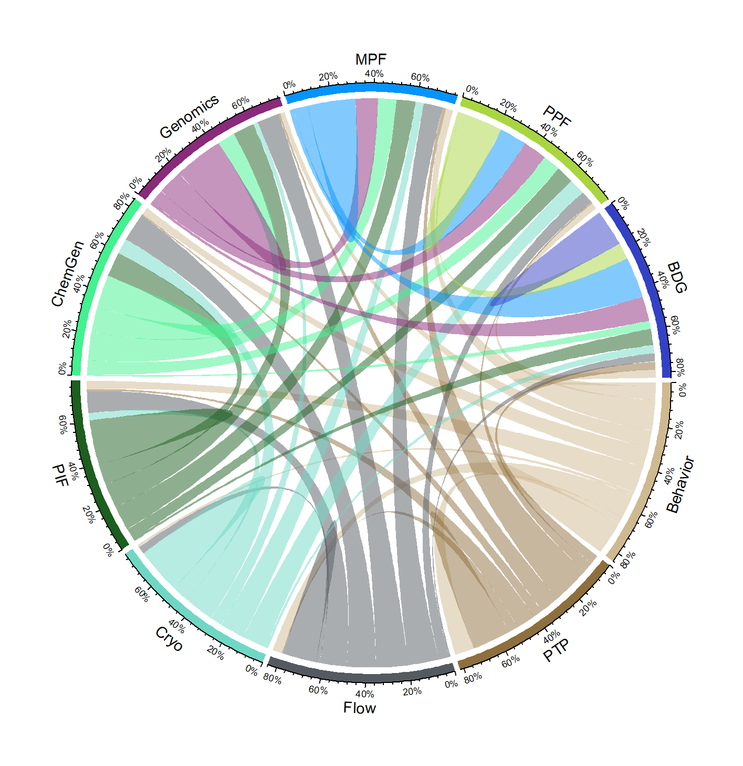
The Core Facility Ecosystem
Research is increasingly interdisciplinary
Many faculty depend on more than one core to support research programs
For any given core, about 60% of their users are also using at least one other core
Small cores can be just as important to the overall health of the research enterprise as large ones

Slide 16
Faculty Recruitment
Very difficult to measure directly!

Slide 17
Who’s funding the work?
Between 2023 and 2025, on average:
36% of all DHHS expenditures came from grants using core facilities
19% of all USDA expenditures came from grants using core facilities
10% of all NSF expenditures came from grants using core facilities

Slide 18
One Health Initiative
Tackle complex challenges with real-world impact at the intersection of human, animal and plant health
One Health research extends from agriculture to veterinary medicine, drug discovery and cancer research to population health and mental health

Slide 19
Cores as Research Enablers
Investment
$2,444,141
Return on investment
34X
Direct Income
$1,801,671
F&A Return
$748,918
Additional grant expenditure supported
$80,738,125
$83.3M in total research expenditure enabled

Slide 20
What do we do with all this data?
Part 3 - Education
Education:
Training students is educational – can we track student trainees separate from users?
How do the cores support student success in their education?

Slide 21
Trainees, not just users

Slide 22
Supporting Student Success

Slide 23
What’s next?
Operations – Data Lake and Digital Twins
Continue to integrate various data sources to create a data lake which can be queried for insights
Can we set up digital twins of the instruments so that core staff can monitor instrument health in real time and catch small problems before they become big problems?
Research - Biodata initiative
Establish scientific data workflows in all cores that will allow proper indexing of data and metadata to ensure data meets FAIR standards and is AI readable
Will require expanded LIMS systems that should also allow more insight into core workflows
Education - Micro-credential program
Set up a mini-course for undergraduate students in mass spectrometry

Slide 24
Thank you
Natasha Nikolaidis
Associate Director of Operations, Bindley Bioscience Center
nnikolai@purdue.edu

